Slide 1
Hardware Multithreading

Slide 2
What is parallelism in computer architecture?
In computer architecture, parallelism is the use of multiple processors to execute a set of instructions at the same time. Parallelism can be used to increase the performance of a computer by reducing the amount of time needed to execute a set of instructions.

Slide 3
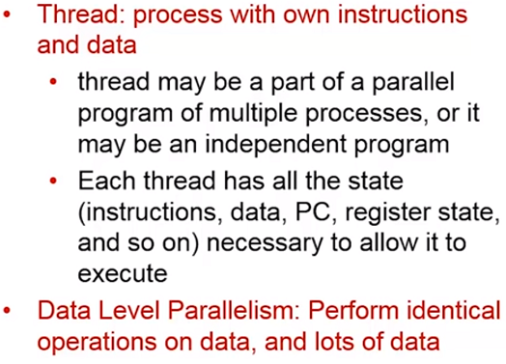

Slide 4
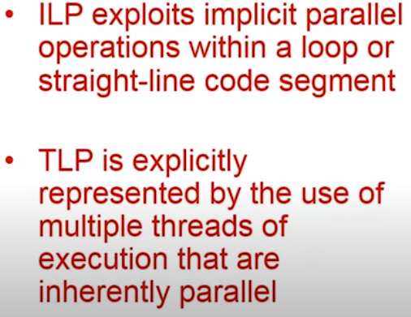

Slide 5
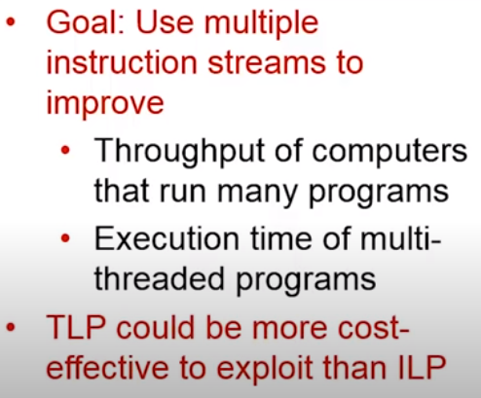

Slide 6
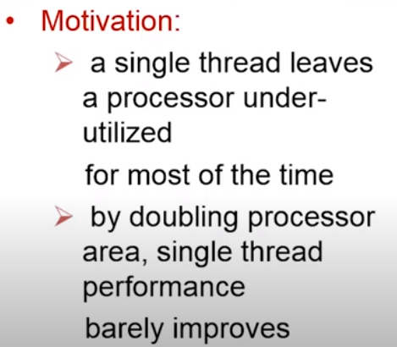
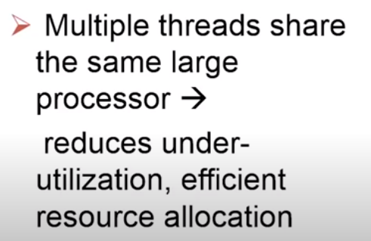

Slide 7
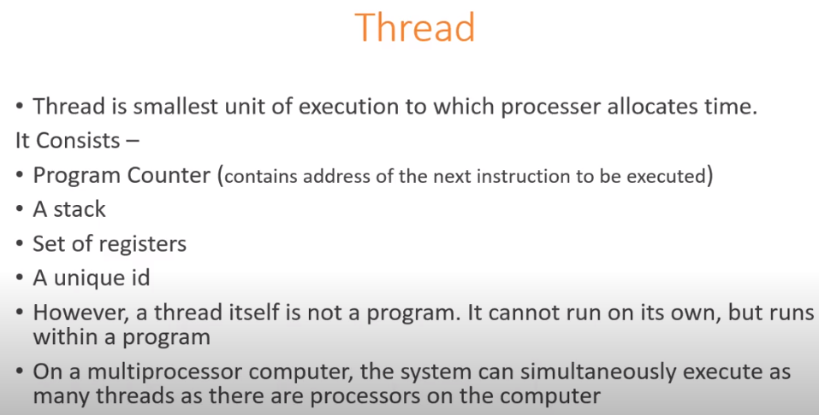

Slide 8
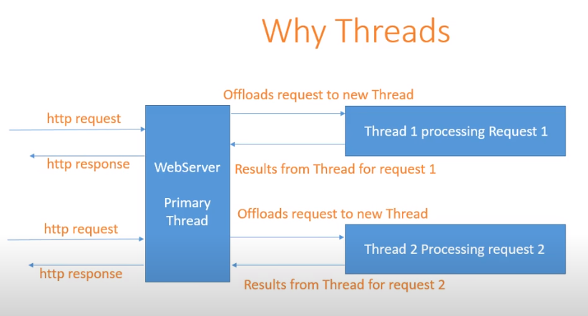

Slide 9
Hardware multithreading
Thread
Light weight process which shares a single address space
Includes PC, register state and stack.
Process
One or more threads, address space, OS state.
Hardware Multithreading
Increasing utilization of a processor by switching to another thread when one thread is stalled.

Slide 10
Hardware Multithreading
Hardware multithreading allows multiple threads to share the functional units of a single processor in an overlapping fashion to try to utilize the hardware resources efficiently.
1. Fine Grained Multithreading
2. Coarse Grained Multithreading
3. Simultaneous Multithreading

Slide 11
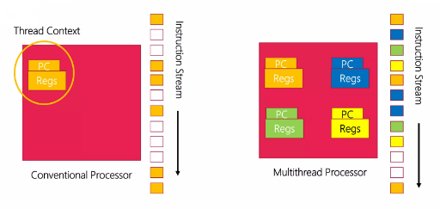
Hardware Multithreading

Slide 12
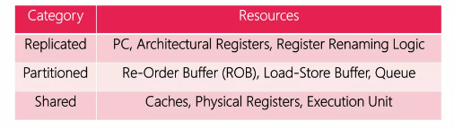
Resource sharing in multithreaded processor

Slide 13
Coarse Grained Multithreading (CGMT)
We always executes instructions from a single thread continuously
Thread scheduling: Thread switching on long latency events (L2 cache misses)
Pipeline partitioning: Pipeline will not be partitioned, flushing.
Simple, Improved throughput, low cost
Not suitable for out-of-order processing.

Slide 14
Fine Grained Multithreading (FGMT)
Thread scheduling: Thread Switching on every clock cycle (Round Robin)
Pipeline Partitioning: Dynamic, No flush
Conceptually simple, High throughput
Very poor single thread performance

Slide 15
Simultaneous Multithreading (SMT)
FGMT + Superscalar processing
Thread scheduling: Thread switching on every clock cycle (round robin)
Pipeline Partitioning: Dynamic, No flush
Improved throughput, hide memory latency
Resource Partioning: Static and dynamic
Increased conflict in shared resources

Slide 16
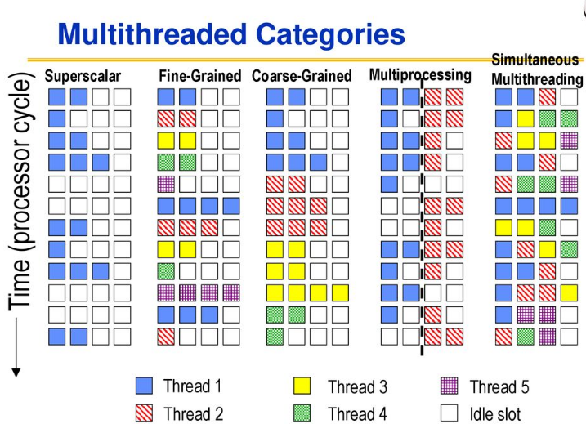

Slide 17
Vector (SIMD) Processing

Slide 18
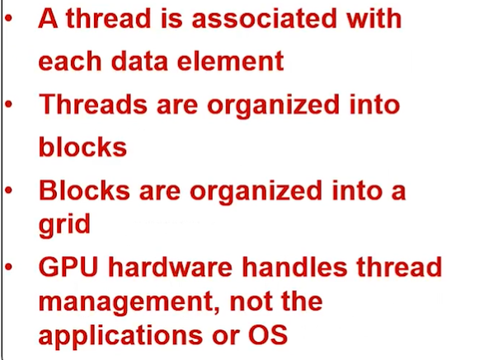

Slide 19
Data Parallelism
Concurrency arises from performing the same operations on different pieces of data
Single instruction multiple data (SIMD)
E.g., dot product of two vectors
Contrast with data flow
Concurrency arises from executing different operations in parallel (in a data driven manner)
Contrast with thread (“control”) parallelism
Concurrency arises from executing different threads of control in parallel
SIMD exploits instruction-level parallelism
Multiple instructions concurrent: instructions happen to be the same

Slide 20
SIMD Processing
Single instruction operates on multiple data elements in time or in space
Multiple processing elements
Time-space duality
Array processor: Instruction operates on multiple data elements at the same time
Vector processor: Instruction operates on multiple data elements in consecutive time steps

Slide 21
What is the difference between array and vector processing?
Arrays are groups of data elements that are kept in close proximity to one another in memory. They’re frequently used to symbolize parallel-processable datasets, while the term “vector processing” describes the simultaneous processing of many data units using specialized technology.

Slide 22
Why are vector processors better than traditional processors?
This means that vector processors can perform computations faster than traditional processors, particularly for tasks that involve repeated operations on large datasets. Scalability: Vector processors can scale up to handle larger datasets without sacrificing performance.

Slide 23
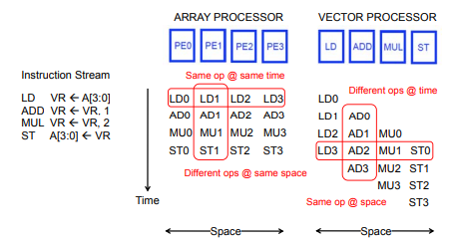
Array vs. Vector Processors

Slide 24
Vector Processors
A vector is a one-dimensional array of numbers
Many scientific/commercial programs use vectors
for (i = 0; i<=49; i++)
C[i] = (A[i] + B[i]) / 2
A vector processor is one whose instructions operate on vectors rather than scalar (single data) values
Basic requirements
Need to load/store vectors vector registers (contain vectors)
Need to operate on vectors of different lengths vector length register (VLEN)
Elements of a vector might be stored apart from each other in memory vector stride register (VSTR)
Stride: distance between two elements of a vector

Slide 25
A vector instruction performs an operation on each element in consecutive cycles
Vector functional units are pipelined
Each pipeline stage operates on a different data element
Vector instructions allow deeper pipelines
No intra-vector dependencies no hardware interlocking within a vector
No control flow within a vector
Known stride allows prefetching of vectors into cache/memory

Slide 26
Vector Processor Advantages
+ No dependencies within a vector
Pipelining, parallelization work well
Can have very deep pipelines, no dependencies!
+ Each instruction generates a lot of work
Reduces instruction fetch bandwidth
+ Highly regular memory access pattern
Interleaving multiple banks for higher memory bandwidth
Prefetching
+ No need to explicitly code loops
Fewer branches in the instruction sequence

Slide 27
The vector instruction
VectorAdd.S Vi, Vj, Vk
computes L sums using the elements in vector registers Vj and Vk, and places the resulting sums in vector register Vi. Similar instructions are used to perform other arithmetic operations.
Special instructions are needed to transfer multiple data elements between a vector register and the memory. The instruction
VectorLoad.S Vi, X(Rj)
causes L consecutive elements beginning at memory location X + [Rj] to be loaded into vector register Vi. Similarly, the instruction
VectorStore.S Vi, X(Rj)
causes the contents of vector register Vi to be stored as L consecutive elements in the memory.

Slide 28
Vectorization
In a source program written in a high-level language, loops that operate on arrays of integers or floating-point numbers are vectorizable if the operations performed in each pass are independent of the other passes.
Using vector instructions reduces the number of instructions that need to be executed and enables the operations to be performed in parallel on multiple ALUs.
A vectorizing compiler can recognize such loops, if they are not too
complex, and generate vector instructions.

Slide 29
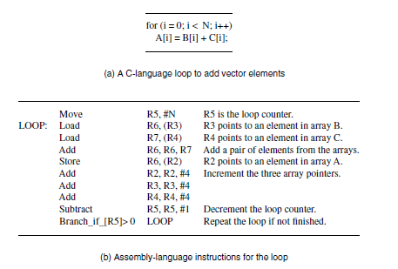
Example of loop vectorization

Slide 30
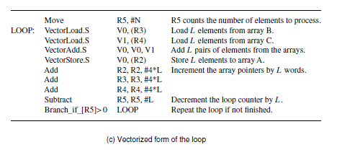
Example of loop vectorization

Slide 31
Graphics Processing Units (GPUs)
The increasing demands of processing for computer graphics has led to the development of specialized chips called graphics processing units (GPUs).
The primary purpose of GPUs is to accelerate the large number of floating-point calculations needed in high-resolution three-dimensional graphics, such as in video games.
A large GPU chip contains hundreds of simple cores with floating-point ALUs to perform them in parallel

Slide 32
The processing cores in a GPU chip have a specialized instruction set and hardware architecture, which are different from those used in a general-purpose processor.
An example is the Compute Unified Device Architecture (CUDA) that NVIDIA Corporation uses for the cores in its GPU chips.
To facilitate writing programs that involve a general-purpose processor and a GPU, an extension to the C programming language, called CUDA C, hasbeen developed by NVIDIA

Slide 33
Cache Coherence

Slide 34
What is cache memory and why is it important?
Cache memory is a type of computer memory for temporary storage of important, frequently accessed information. Reading from and writing to cache memory is much faster than other forms of data storage. By storing data in cache memory, you can dramatically speed up time-consuming or high-volume transactions.

Slide 35
Cache Coherence
A shared-memory multiprocessor is easy to program. Each variable in a program has a unique address location in the memory, which can be accessed by any processor.
However, each processor has its own cache.
When any processor writes to a shared variable in its own cache, all other caches that contain a copy of that variable will then have the old, incorrect value.
They must be informed of the change so that they can either update their copy to the new value or invalidate it.
This is the issue of maintaining cache coherence, which requires having a consistent view of shared data in multiple caches

Slide 36
Write-Through Protocol
A write-through protocol can be implemented in one of two ways. One version is based on updating the values in other caches, while the second relies on invalidating the copies in other caches.
Write-Back protocol
Maintaining coherence with the write-back protocol is based on the concept of ownership of a block of data in the memory. Initially, the memory is the owner of all blocks, and the memory retains ownership of any block that is read by a processor to place a copy in its cache.

Slide 37
Snoopy Caches
In a single-bus system, all transactions between processors and memory modules occur via requests and responses on the bus.
In effect, they are broadcast to all units connected to the bus.
Suppose that each processor cache has a controller circuit that observes, or snoops, all transactions on the bus.
Directory-Based Cache Coherence
The concept of snoopy caches is easy to implement in single-bus systems.
Large shared memory multiprocessors use interconnection networks such as rings and meshes.
In such systems, broadcasting every single request to the caches of all processors is inefficient.
A scalable, but more complex, solution to this problem uses directories in each memory module to indicate which nodes may have copies of a given block in the shared state.

